Slide 1


Slide 2


Slide 3
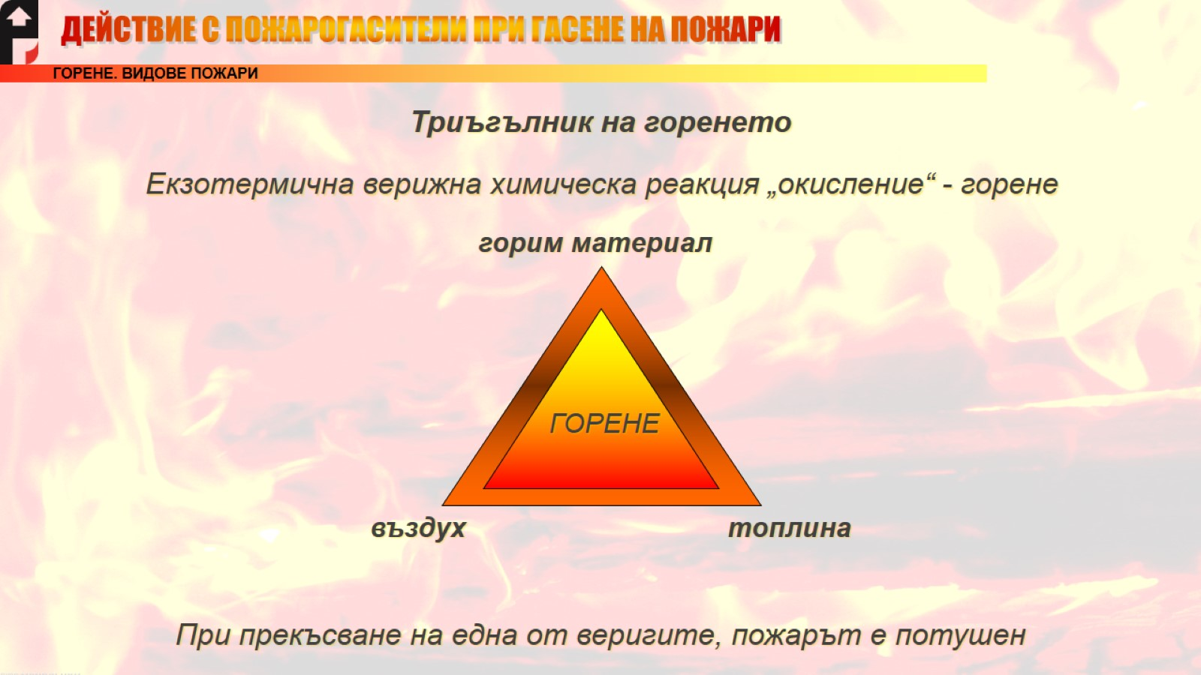

Slide 4
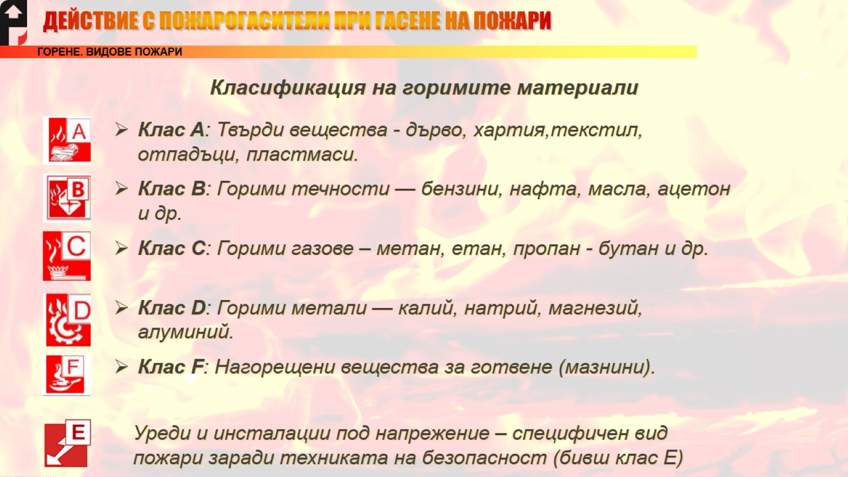

Slide 5


Slide 6
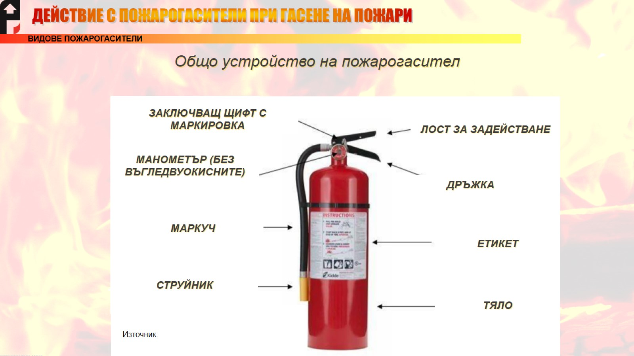
Общо устройство на пожарогасител
https://www.iitmandi.ac.in/research/amrc/fire_safety.pdf

Slide 7
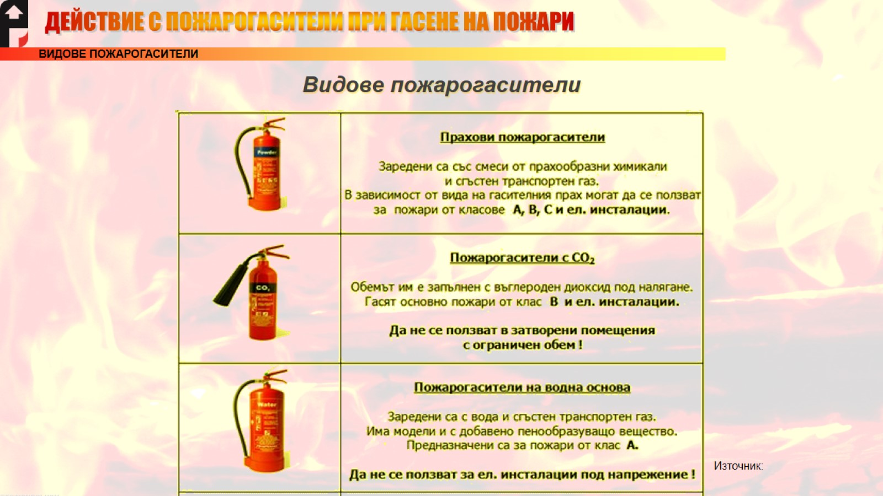
Видове пожарогасители
https://psnedev.com//

Slide 8
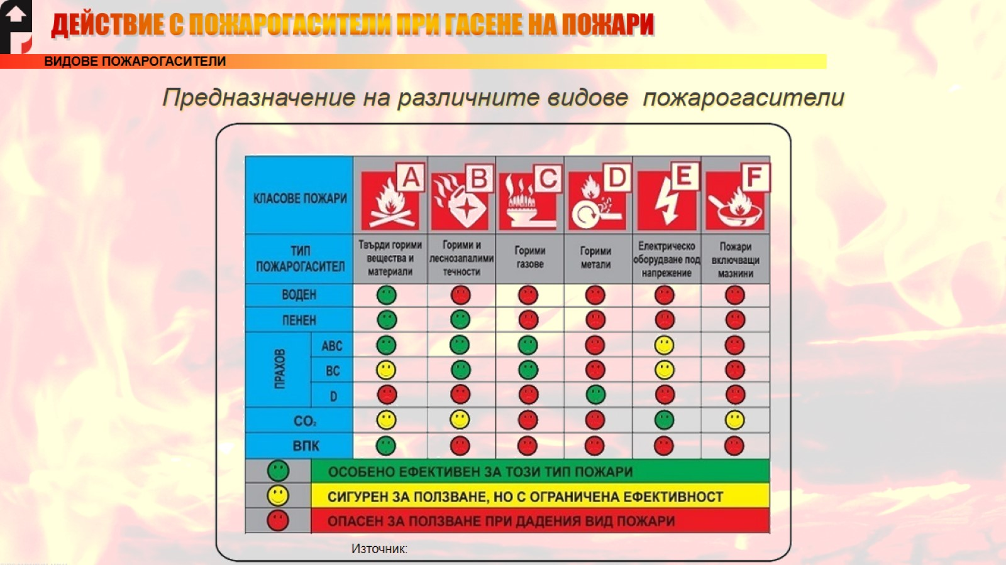
Предназначение на различните видове пожарогасители
https://otgovori.info/tag/pozharogasiteli/

Slide 9
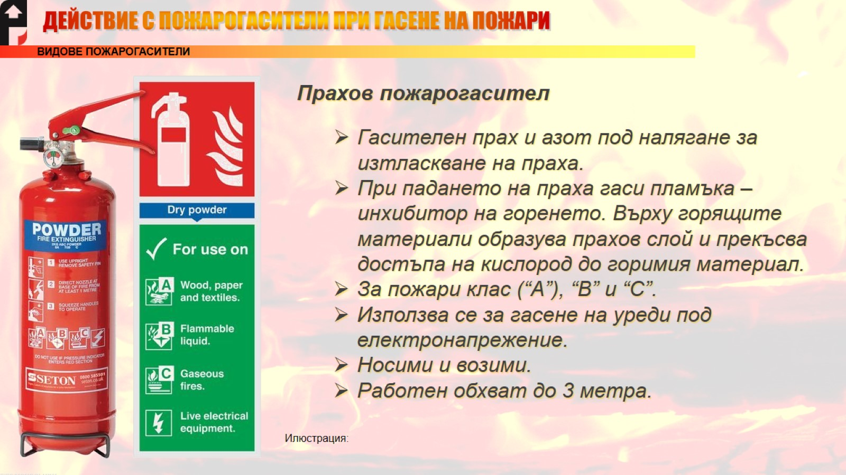
https://www.seton.co.uk/abc-powder-extinguisher-instruction-sign-bundle.html#304DAB100

Slide 10
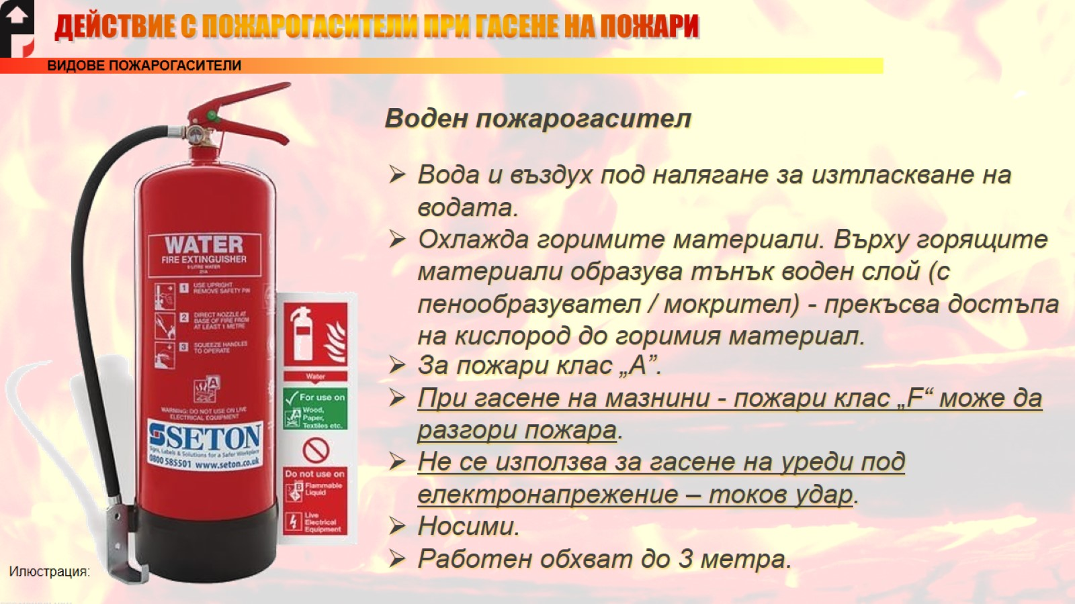
https://www.seton.co.uk/water-fire-extinguisher-kits.html#301WTA100

Slide 11
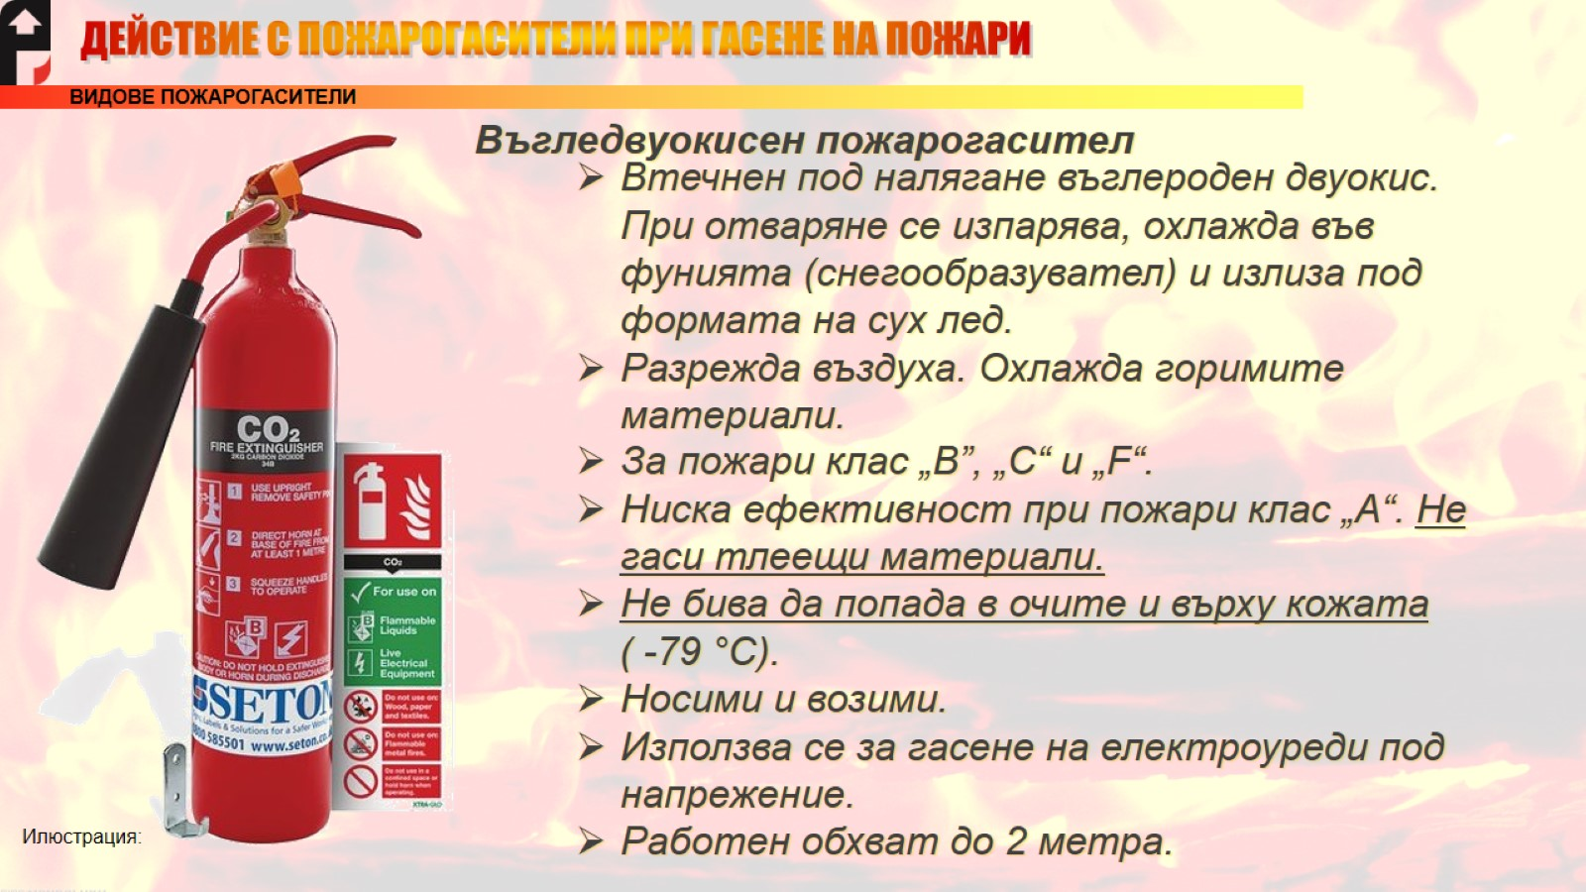
https://www.seton.co.uk/co2-fire-extinguisher-kits.html#301WQA100

Slide 12


Slide 13

https://audibg.com/

Slide 14


Slide 15
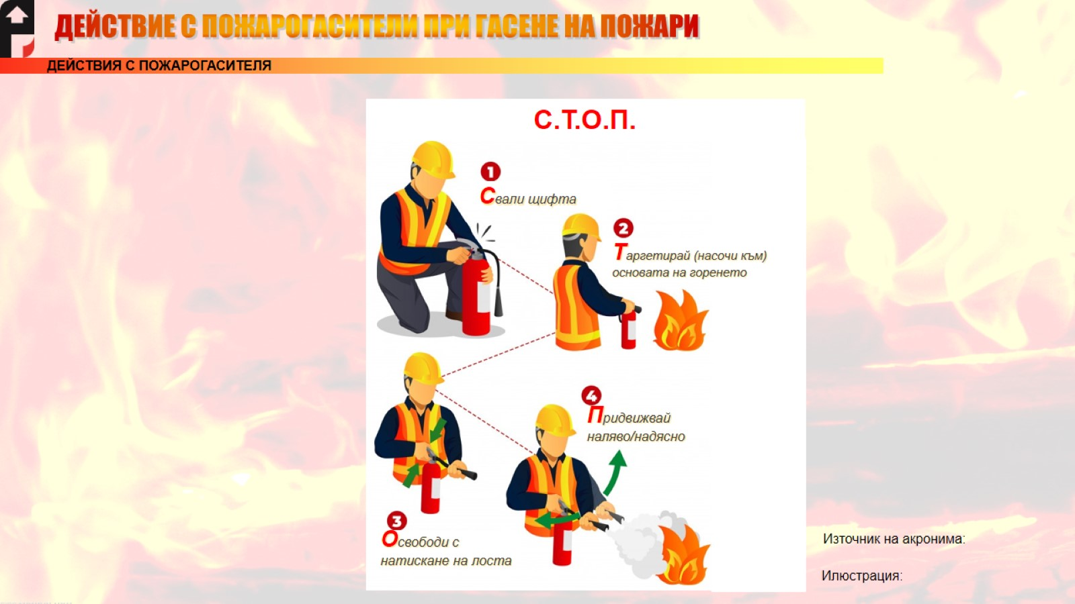
https://пожарназащита.com
Илюстрация:

Slide 16


Slide 17
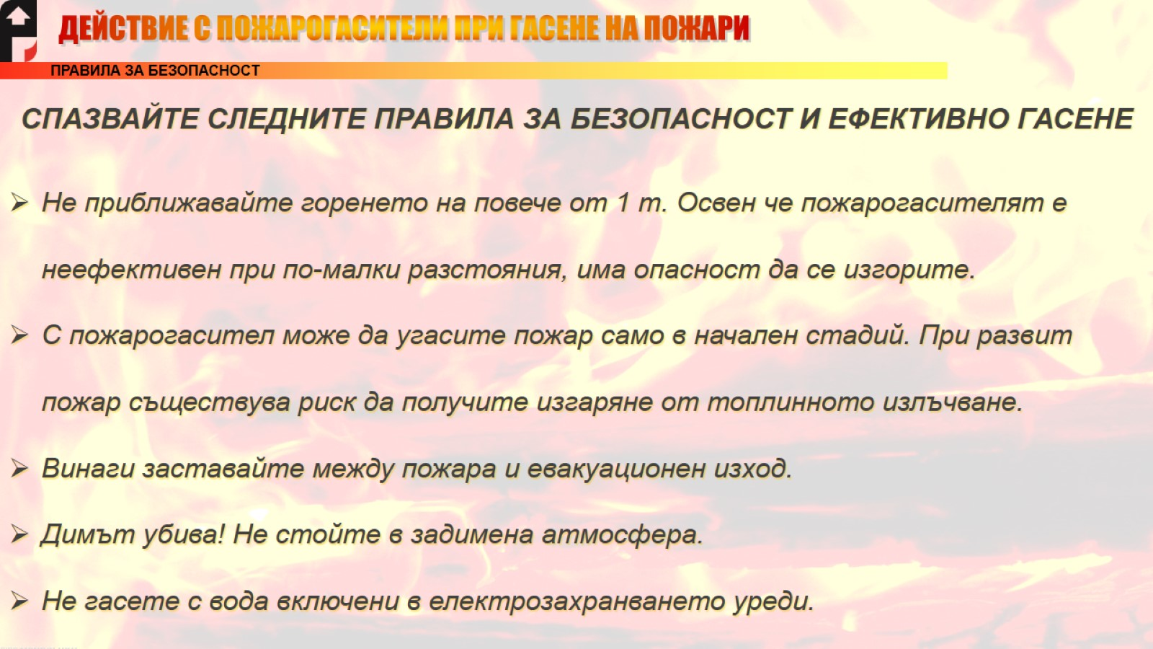

Slide 18


